Slide 1
Gravitational Lensing and Quasars
“A man should look for what is, and not what he thinks should be.” – Albert Einstein
Arvind Haran and David Johnston

Slide 2
What is Gravitational Lensing?
Let’s take a step back to the Einstein days…
General Theory of Relativity
Space/time is dynamic and changing; not static
Mass bends and changes space
Gravitational Lensing – the act of observing and measuring the mass that bends space-time and the masses that are effected by this

Slide 3
Effects of Gravitational Lensing?
Distortion of light from the background objects
Leads to a distortion in appearance of the object
Distortion of the lensed object’s position in space
HOW!?
- Light follows the path through bent space

Slide 4
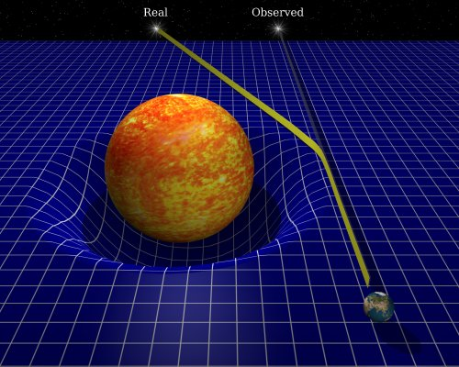
Background Object(s)
Lensing Object
Earth

Slide 5
Two Major Types:
Strong Lensing
Easily visible distortions in the lensed object
Einstein Rings, arcs, etc.
Near “perfect” situations
Lens and lensed object are directly in line with each other

Slide 6
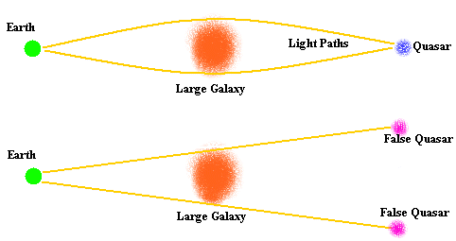
What Happens:

Slide 7
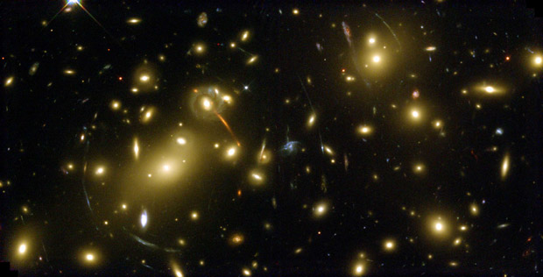
Example:

Slide 8
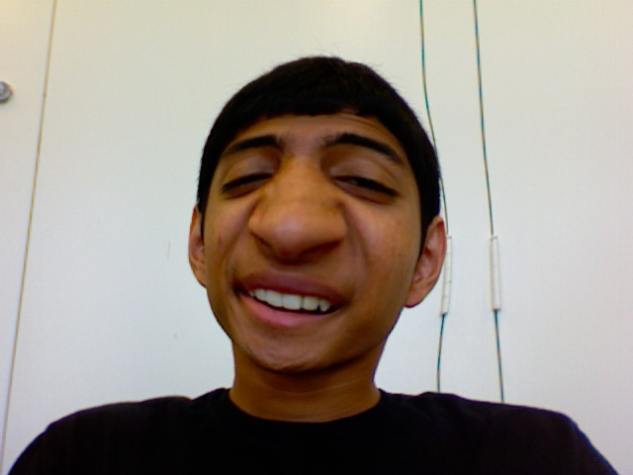
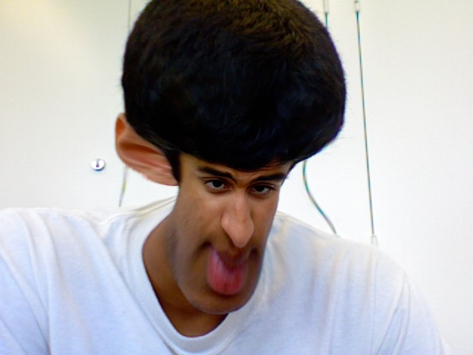
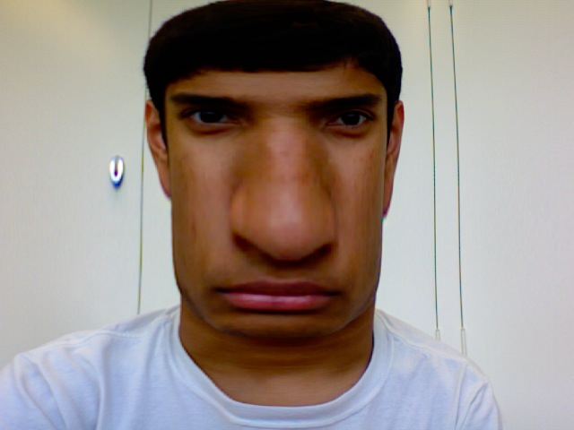
More Examples…

Slide 9
Two Types:
2. Weak Lensing
Very small distortions in the lensed object
Need to analyze large number of sources to obtain the average percent of distortion in background objects
From this, we can determine the mass distribution in the area

Slide 10
Background Objects
Lensing Object
Background Objects

Slide 11
Weak Lensed Background Objects
Lensing Object
Weak Lensed Background Objects

Slide 12
What are Quasars?
One of the brightest and most energetic objects in the universe
One of the most distant objects in the universe
Believed to lie in the center of massive galaxies
Believed to be powered by supermassive black holes

Slide 13
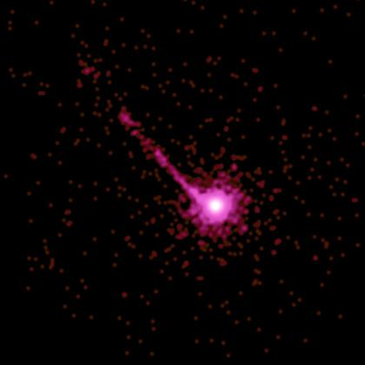
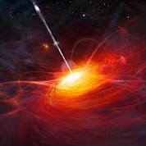
Examples:

Slide 14
Our Project:
Quasars = lensing object
Galaxies behind = background sources
Using WEAK GRAVITATIONAL LENSING

Slide 15
Earth
QSO
Background Galaxies

Slide 16
The Goals:
To measure weak gravitational lensing effects on quasars
To determine whether making these measurements are possible (high signal/noise ratio)
To discover the average mass of quasars
To learn more about the formation of quasars and their origins
Rule out fringe theories about quasars

Slide 17
The Challenges:
Quasars are very distant objects
Many galaxies lie in front of quasars
Potential for high levels of noise
Low amounts of signal
Programming in IDL
I don’t like “for” loops, by the way
Amount of time given

Slide 18
The First Step:
Obtain data of quasars and galaxies
From SDSS.org
SQL search
Searched for:
Quasars with spectra
Photometric galaxies

Slide 19
Galaxy/QSO Distribution
Plotted the “Right Ascension” and “Declination” coordinates of the galaxies/QSO’s
Highlighted galaxies within QSO radius of 1 MPC
Highlighted galaxies within the QSO radius that are more distant than the QSO
Used redshift
This gives us a 3-D map of galaxy and QSO positions in space

Slide 22
Next…
Find the number of Galaxies and QSO’s per Degree^2
By redshift
This helps determine the numerical distribution of galaxies/QSO’s

Slide 24
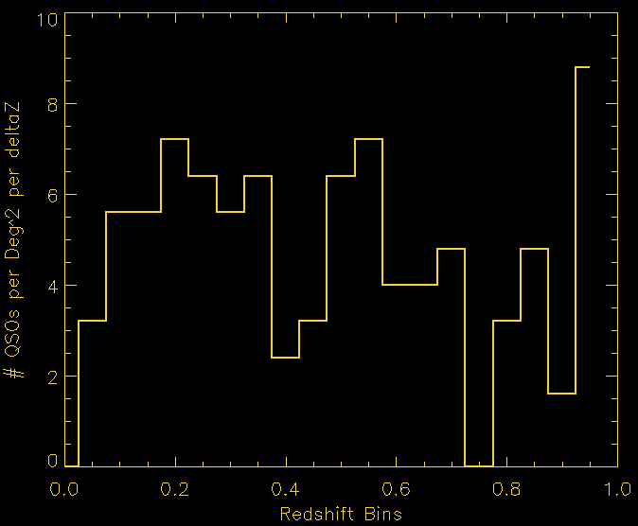

Slide 25
Find the # of Pairs
Galaxy Histogram was a cumulative graph, which means that it takes all the galaxies that are greater than that particular redshift.
QSO Histogram simply shows how many QSO’s are present per Deg^2 by redshift.
In order to find the # of pairs, we must find how many galaxies are behind the QSO’s for every redshift bin

Slide 26
QSO
(Lens Object)

Slide 27
How?
Find the Area around the quasar
Find the average # of galaxies per quasar
Find the # of quasars per redshift
(# of QSO’s) x (# of background galaxies per QSO) = # of pairs

Slide 28
Variables
A = Area around QSO
Pgals(z) = # of galaxies per Deg^2
Output values from previous Galaxy Histogram
Ngals(>z) = average # of background galaxies per QSO
Nqso(z) = # of QSO’s per redshift
Output values from previous QSO Histogram
Npairs(z) = # of galaxy/QSO pairs at QSO redshift (z)

Slide 29
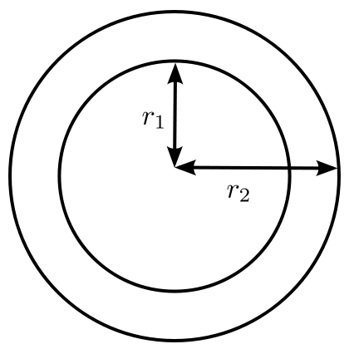
Step 1: Area (MPC)
Annulus Area:
A = π(R2^2 – R1^2)

Slide 30
Step Two:
Find the Average # of Galaxies per QSO (Ngals)
Ngals(>z) = Pgals x A
Pgals = # of galaxies per Deg^2
A = Area around QSO

Slide 31
Step Three:
Find Npairs(z)
# of Galaxy/QSO pairs
Galaxy must be behind the QSO to be considered a pair
Npairs(z) = Nqso(z) x Ngals(>z)
Nqso(z) = # of QSO’s per redshift
Ngals(>z) = average # of background galaxies per QSO

Slide 32
Trend of Npairs:
As QSO redshift increases, the number of galaxy/QSO pairs decreases
The further away the QSO, the less galaxies are behind it. Therefore, there are less pairs.

Slide 34
Finding the Signal/Noise Ratio
Find Inverse Sigma Crit.
Invsigcrit(z) = strength of weak lensing signal
Invsigcrit = (dL x dLS)/dS
dL = distance to lensing object
dLS = distance from lensing object to background object
dS = distance to background object
Why?
Necessary to determine the signal/shear of the lensed objects

Slide 35
How?
Invsigcrit(z) = (dL x dLS)/dS
depends upon redshift of the lensing object and background objects
dS
dL
dLS
Earth
QSO
Background Galaxies

Slide 36
Invsigcrit(z)

Slide 37
Finding the Signal/Noise Ratio
Finding the Delta Sigma
Deltsig(r) = mass density around the QSO
Used a program on IDL called “Isotherm” to do determine the delta sigma

Slide 38
Putting them Both Together:
Signal (shear) = invsigcrit(z) x deltasig(r)
Invsigcrit(z) refers to the strength of the lensing as a function of redshift
Deltasig(r) refers to the mass density around a QSO as a function of its radius

Slide 39
To find Noise…
Noise(z,r) = .3/sqrt(Npairs(z))
Noise is the amount of interference/distortions in measurement
It is a function of redshift and radius combined
Higher redshift = more noise
Higher radius = less noise

Slide 40
Signal/Noise Ratio
Divide the Signal by the Noise
Since there are many redshifts and many possible radii, we made an array of signal/noise ratios
Results:
Lower redshift and radius = higher sig/noise ratio

Slide 42
Final Result:
With a velocity dispersion set as 100, we determined:
A signal/noise ratio of 39.072175
With a velocity dispersion set as 200, we determined:
A signal/noise ratio of 156.28870

Slide 43
Conclusion:
We are now sure that it is possible to make measurements on the weak gravitational lensing of quasars as the lensing objects
Optimal Range for Redshift: 0.0 – 0.35
Many of the goals stated above can be fulfilled if given more time

Slide 44
What I’ve learned:
The basics of programming and IDL
The basic processes of weak gravitational lensing
The importance of accuracy in measurement
How to analyze and utilize data
A TON about astronomy and physics in general.

Slide 45
Special Thanks to:
David Johnston
Chris Stoughton
Jim Browne
George Dzuricsko

