Slide 1
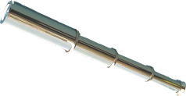
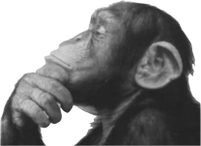
Building Machines for Engagement in Science
Inspiring and Teaching Future Thinkers and Makers
Brian Nord [FNAL]
QuarkNet and the Fermi Mars Rover System
[ nord@fnal.gov ]
Notes:
http://www.jpl.nasa.gov/video/index.php?id=1090

Slide 2
7 Minutes of Terror (by JPL)
http://www.jpl.nasa.gov/video/index.php?id=1090

Slide 3
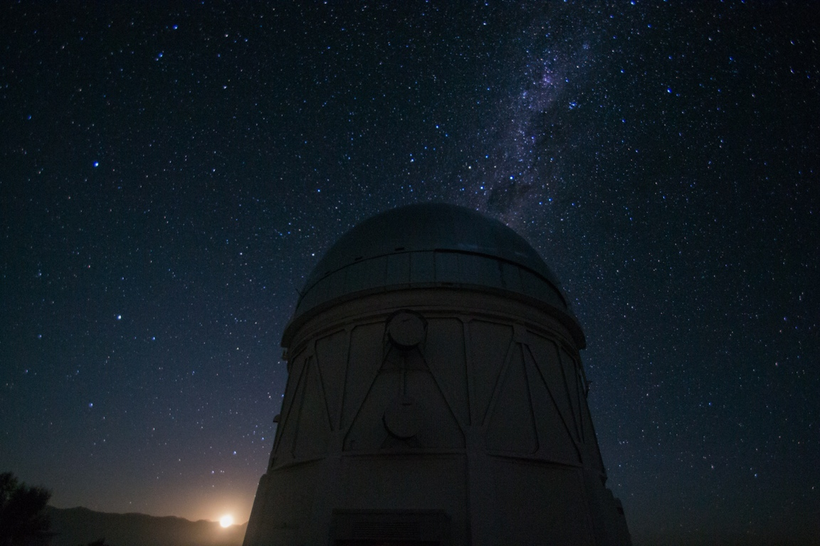

Slide 4
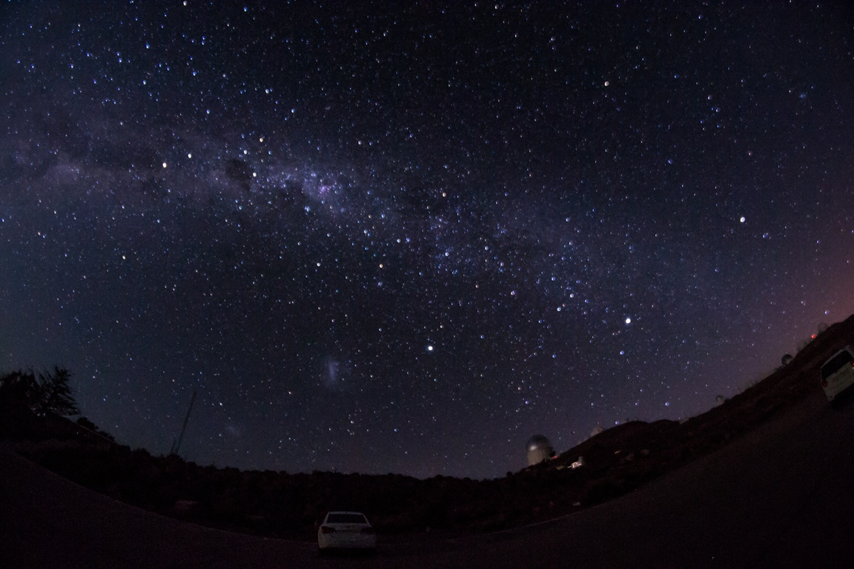

Slide 5
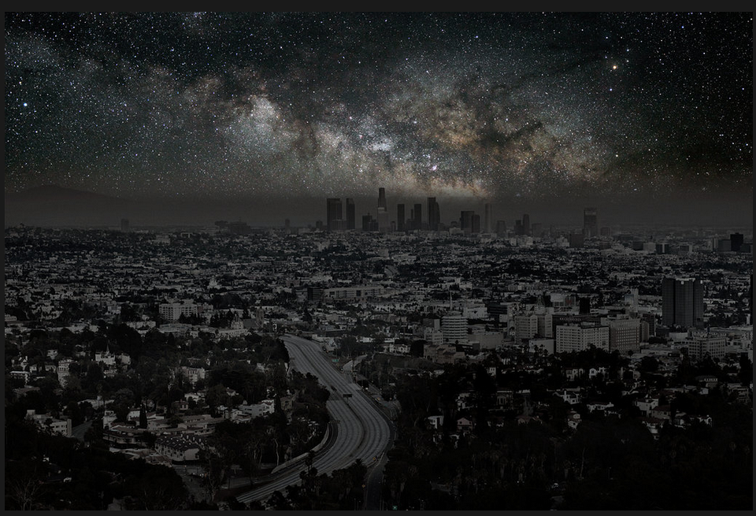
Los Angeles with the lights off.
Few ever see this in our modern age.
Photo Illustration by Thierry Cohen/Danziger Gallery (via New York Times)
http://www.nytimes.com/interactive/2013/02/03/magazine/look-stars.html?_r=0
Notes:
LA if there were not any city lights

Slide 6
“Eight of every 10 kids born in the United States today will never experience a sky dark enough to see the Milky Way.”
-- Paul Bogard via The Atlantic
Notes:
http://www.theatlantic.com/technology/archive/2013/07/let-there-be-night/278070/?utm_content=buffer5d5ba&utm_source=buffer

Slide 7
Piercing the Veil and Modern Science
Notes:
We’ve been piercing the veil for a long time.

Slide 8
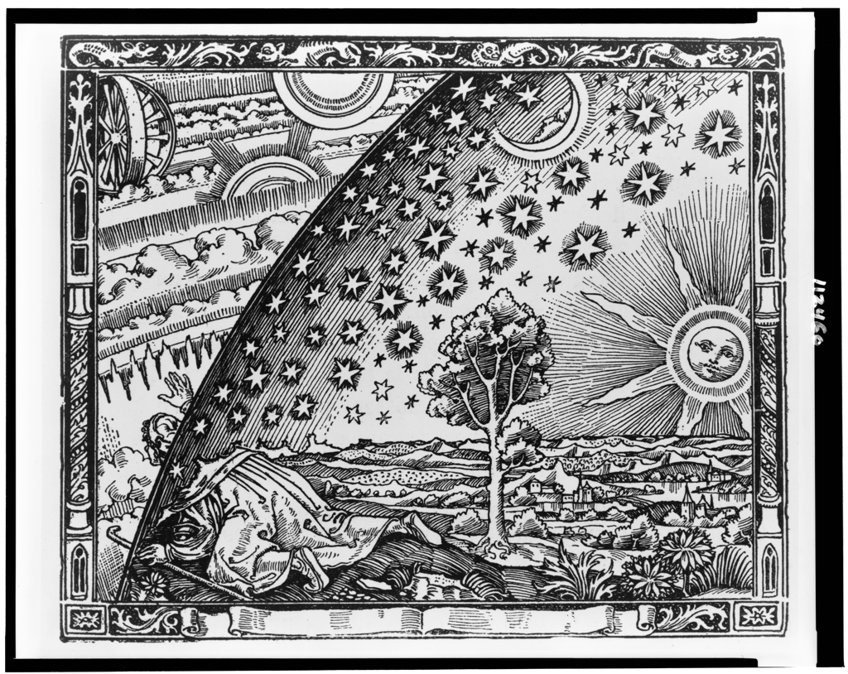
Unknown, Camille Flammarion's L'Atmosphère: Météorologie Populaire (1888); Courtesy of Library of Congress
Notes:
And, as we pierced the veil, we saw more light ...

Slide 9
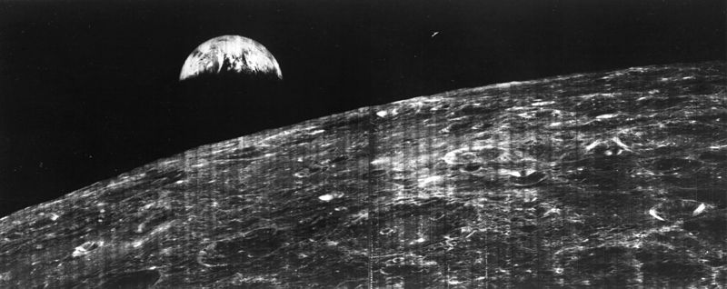
First View of Earth from MoonNASA Lunar Orbiter 1
August 23, 1966
http://grin.hq.nasa.gov/ABSTRACTS/GPN-2000-001588.html
Notes:
Zooming out we have the view from NASA’s Lunar Orbiter 1, which took the first photo of Earth from the Moon’s orbit. This is literally the first time that we saw ourselves. Here, we’re only 375,000 kilometers from Earth.

Slide 10
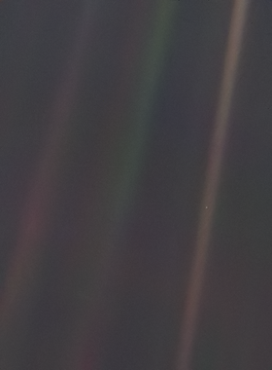
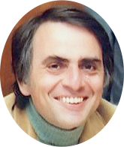
Carl Sagan
Notes:
Zooming out even further, we find just a “Pale Blue Dot,” the moniker popularized by the late, imitable Carl Sagan. <Sagan voice> This image was taken in 1990 by the Voyager 1 space craft as it reached the edge of our solar system. That’s 6 billion km for those who are counting, you could fit 1 million earths end to end from the Earth to this point.
Carl Sagan Planetary Society.JPG
1980
NASA/JPL
http://upload.wikimedia.org/wikipedia/commons/b/be/Carl_Sagan_Planetary_Society.JPG
Pale Blue Dot
1990-06-06
voyager 1
http://visibleearth.nasa.gov/view.php?id=52392

Slide 11
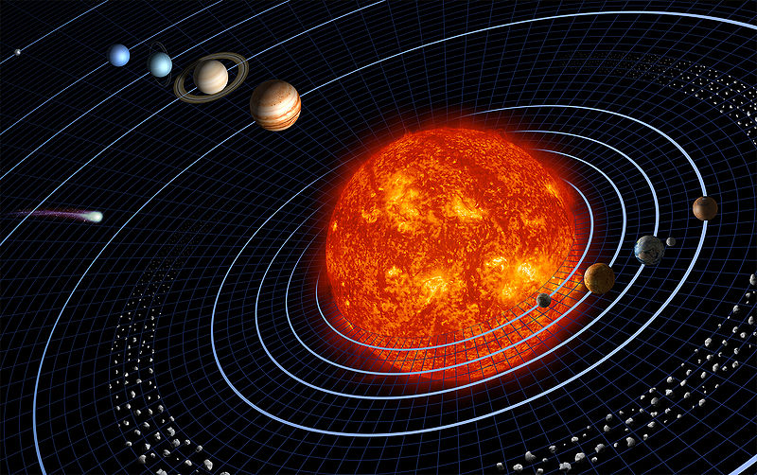
Earth
Harman Smith and Laura Generosa (nee Berwin)
NASA's Jet Propulsion Laboratory
http://upload.wikimedia.org/wikipedia/commons/c/c2/Solar_sys.jpg
Notes:
And if we zoom out just a bit to see our solar system, this is what we might see from above the plane, and there’s us the third rock.
radius [km, parsec] to Pluto
6billion km
0.000194446589 Parsecs
Solar system
Harman Smith and Laura Generosa (nee Berwin)
NASA's Jet Propulsion Laboratory
http://upload.wikimedia.org/wikipedia/commons/c/c2/Solar_sys.jpg

Slide 12
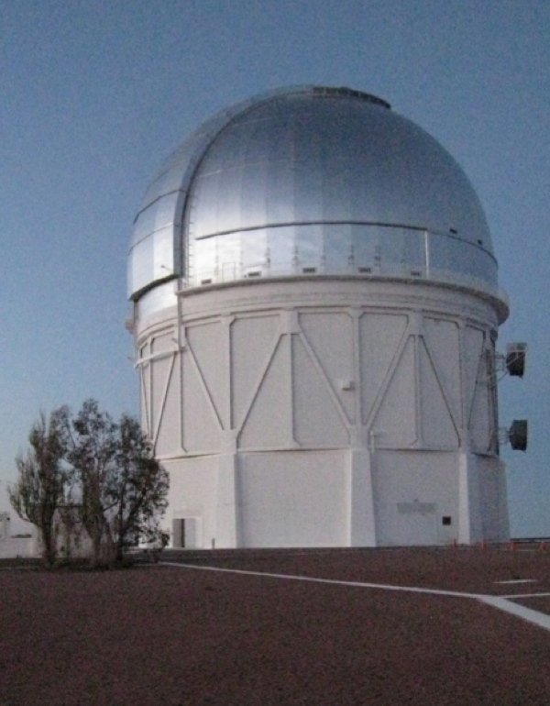

Slide 13
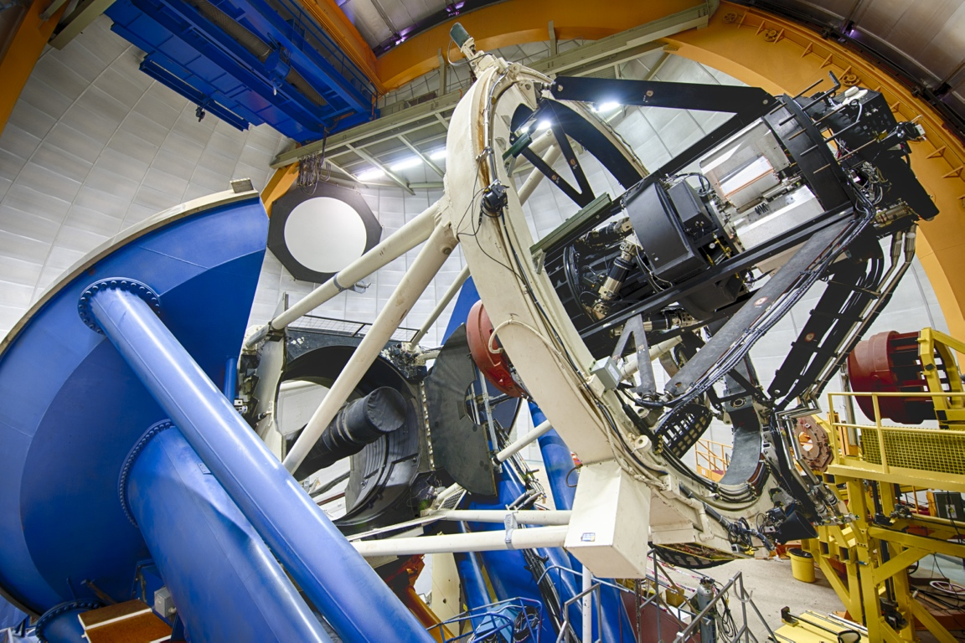

Slide 14
Pop Science and Modern Culture

Slide 15
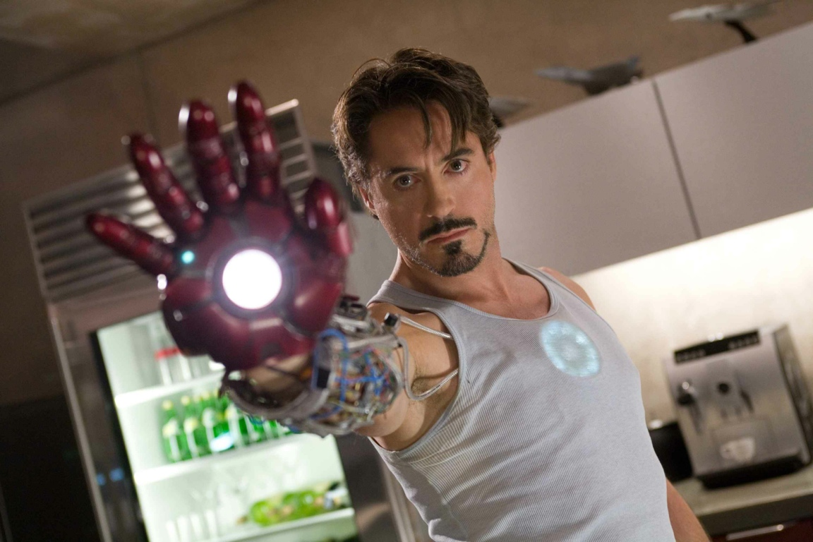
Example 1: Ironman (Marvel Comics)

Slide 16
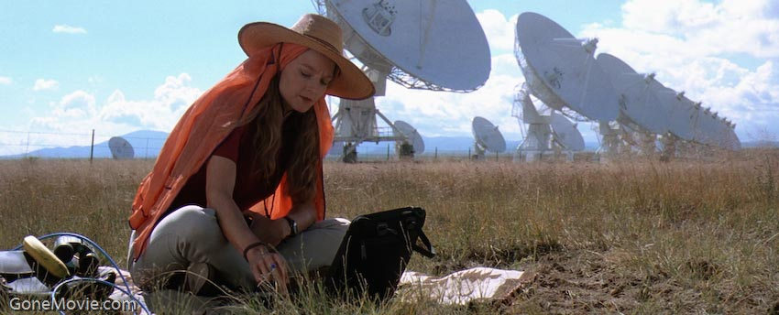
Example 2: Contact
(Film, 1997, based on book by Carl Sagan)

Slide 17
Machines, Science and Project Development Bridging Pop Culture and the Scientific Method

Slide 18
Machines bring together science analysis and project development.
open-ended explorations uniquely exercise many skills needed to be a scientist in the future.
Machine-based science projects bring modern science within reach

Slide 19
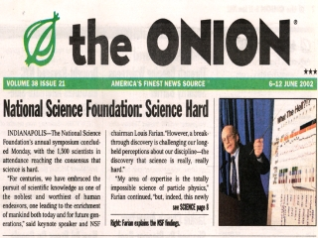

Slide 20
Two Teams, One Planet, One Mission
A Mars Exploration Challenge
Two teams compete to
land rover
operate rover and on-board science instruments
perform science analysis

Slide 21
Simulate Dark Energy Camera

Slide 22
Your Mission to Mars
Establish Mission Goals
Team up by Mission Module
Science and Sensor Design/Choices
Rover Engineering
Control Software Development
Entry, Descent and Landing
Planetary Environment Simulation
Design a mission
Construct Rover
Notes:
http://www.youtube.com/watch?v=N9hXqzkH7YA

Slide 23
Additional Acknowledgments/Credits
Slide 1: http://thebubblechamber.org/wp-content/uploads/2010/10/thinker.jpeg

