Slide 1
Underwater Robotics
Mark Rowzee
Naperville North H.S.
August 2, 2013
QuarkNet

Slide 2
What is ‘underwater robotics’?
Tethered control of a student-designed, student-built, remotely-operated vehicle (ROV)
Camera-eye view operation
Design & build durable vehicle and/or appendages to complete specific tasks
Interact with underwater structures (props)

Slide 3
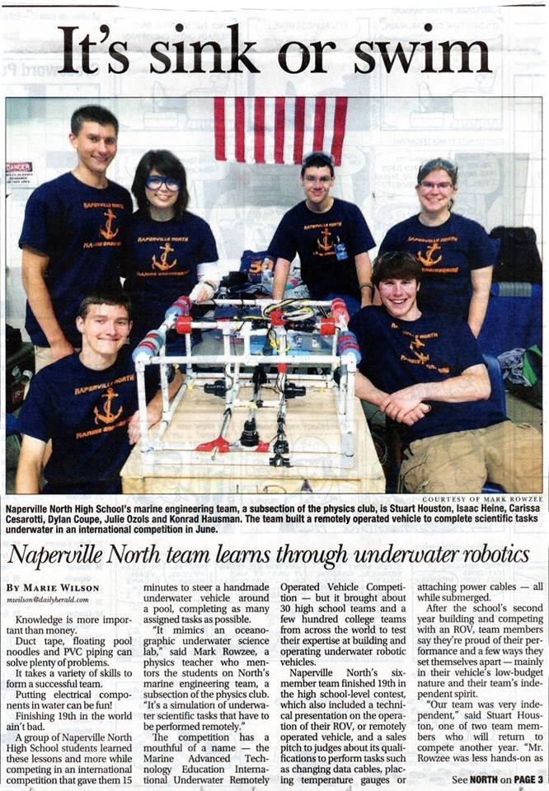

Slide 5
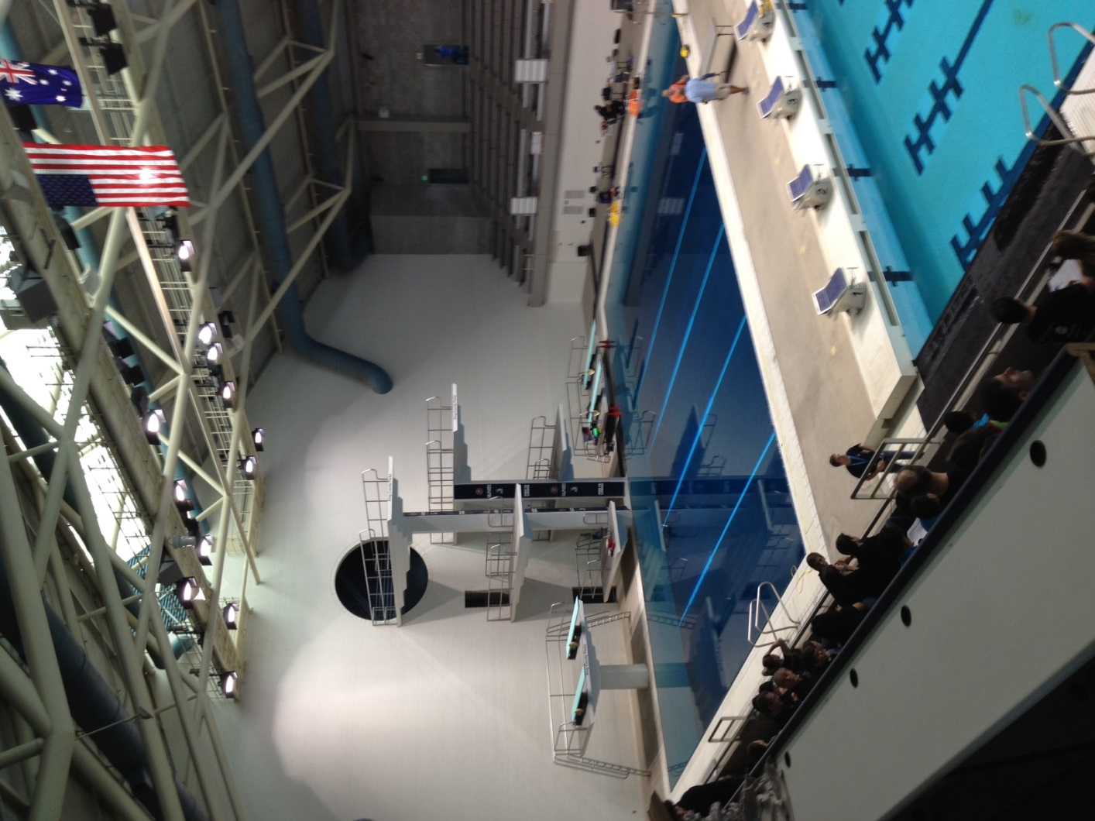

Slide 6
Remotely Operated Vehicles (ROVs)
Perform underwater tasks/simulations
Service offshore drilling platforms
Sampling, turn valves
Shipwreck/archeaological scene
Underwater mapping, collection
Place lift bags, environmental surveys
Underwater science laboratory service
Change batteries/data modules
Floating elevators
Change cables

Slide 7
Parts
Basic
PVC frame
Bilge pump motors w/ propellers
8-strand control wire/ rope tether
Drive switches
Camera feed, battery power
Advanced
Thrusters, joystick control, frame materials, miniature cameras, ballasting tanks, manipulators, lights, motor controllers

Slide 8
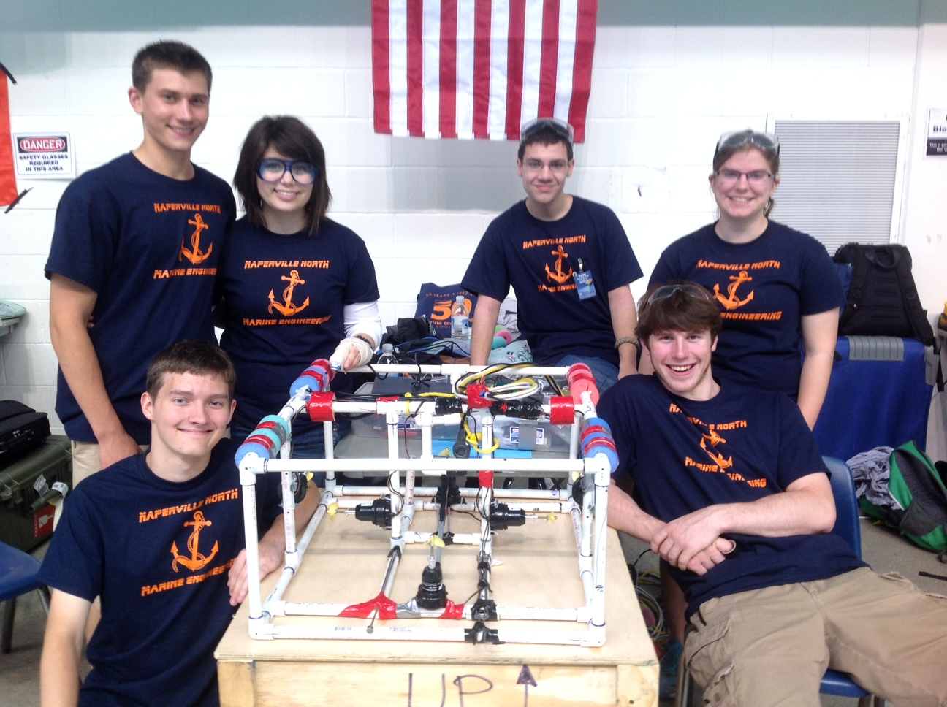

Slide 9
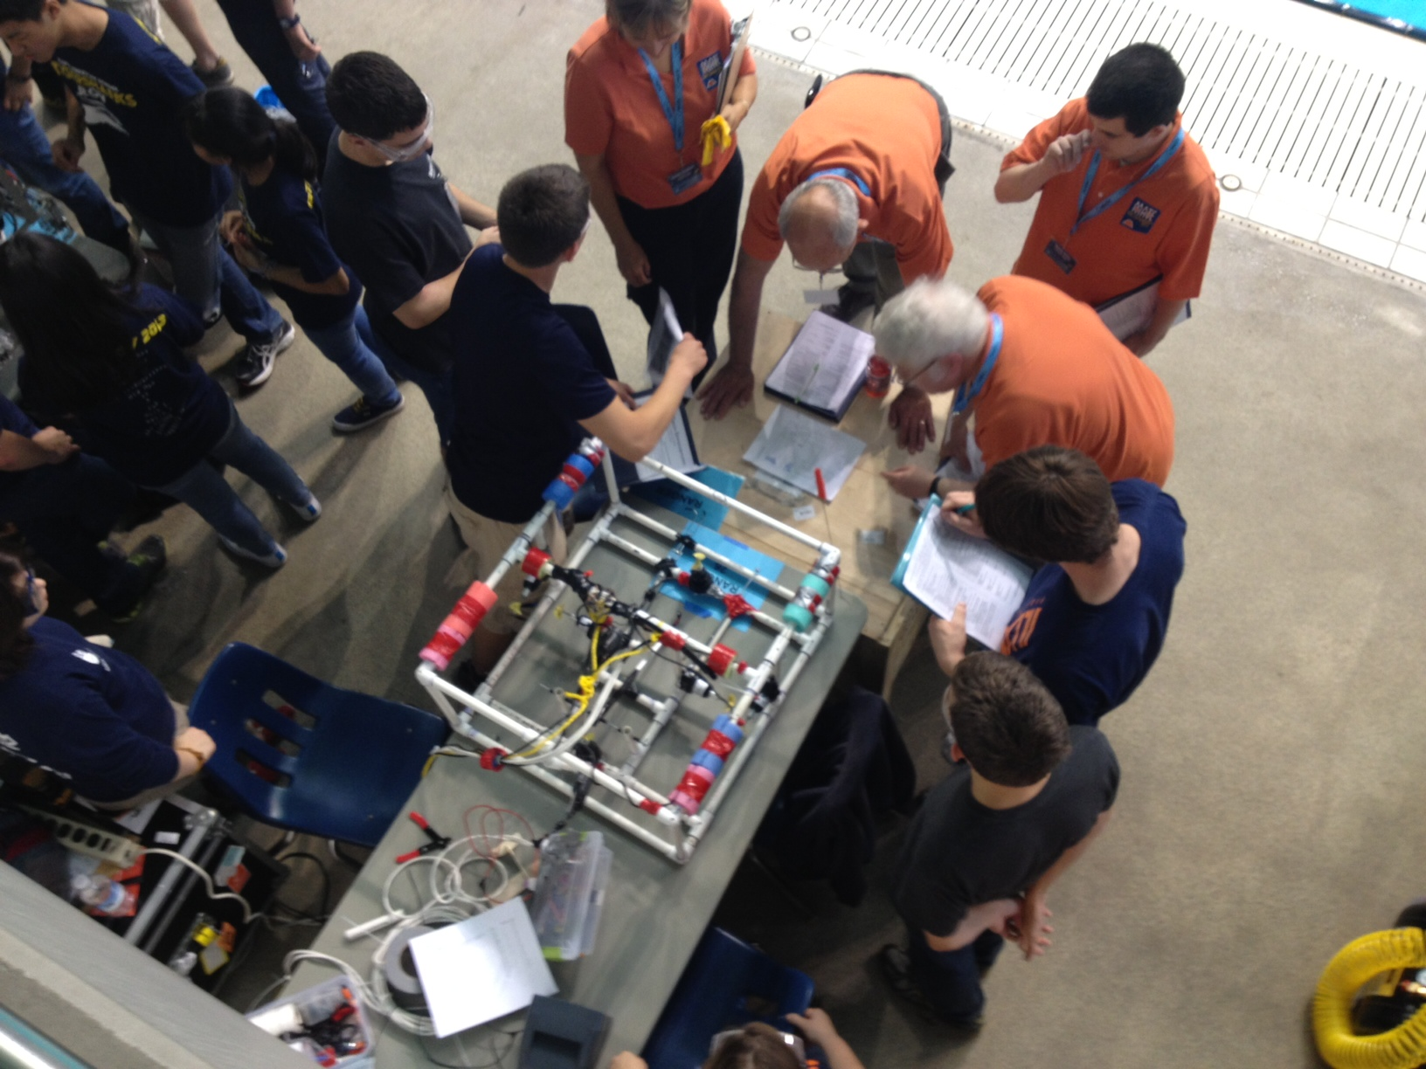

Slide 10
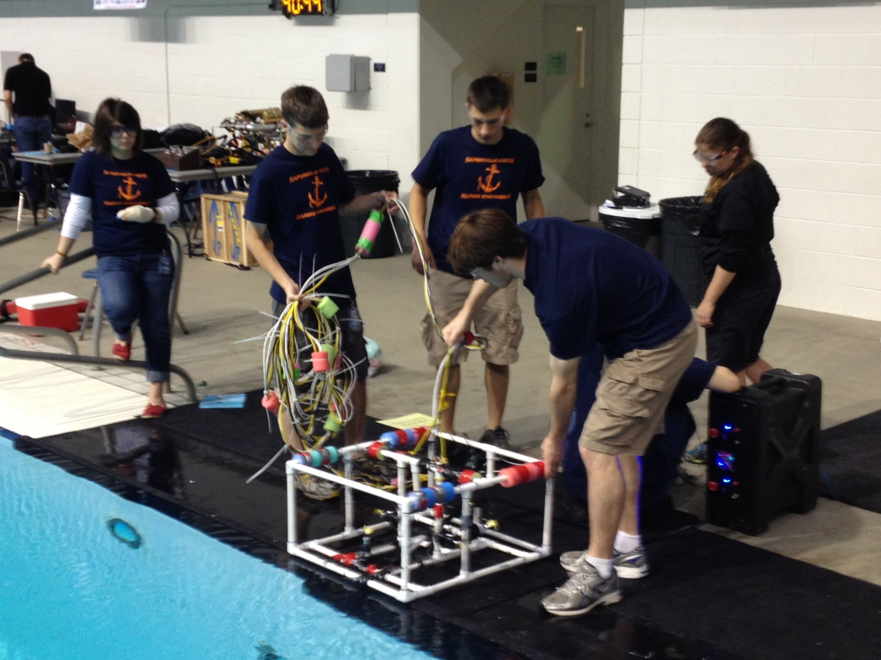

Slide 11
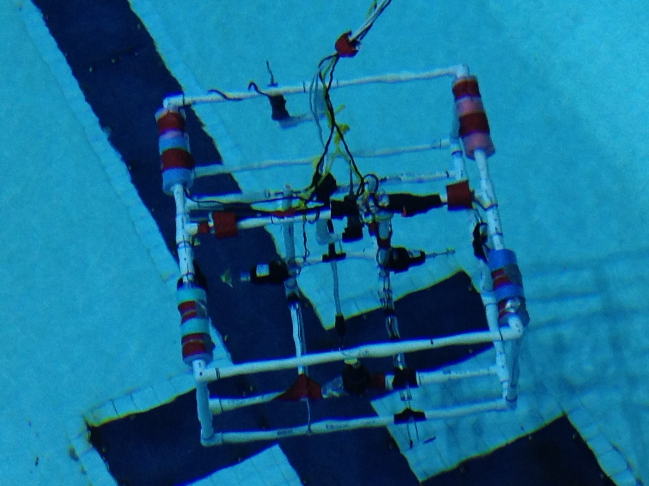

Slide 12
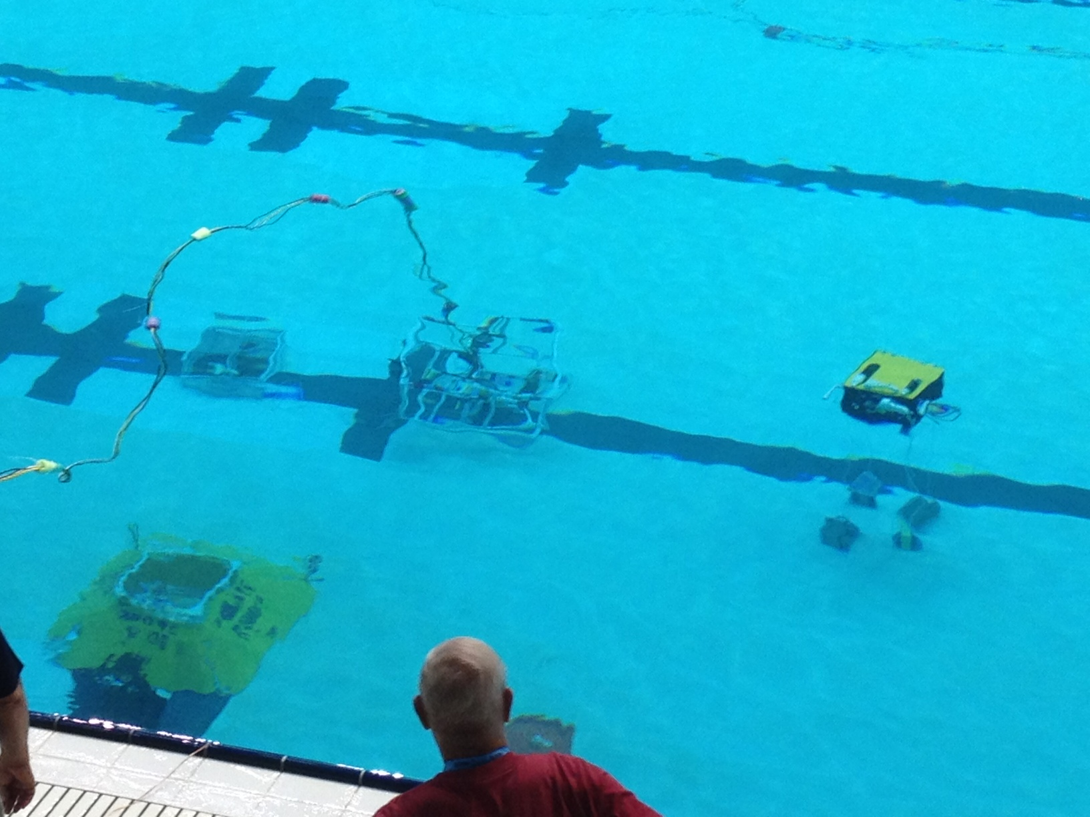

Slide 13
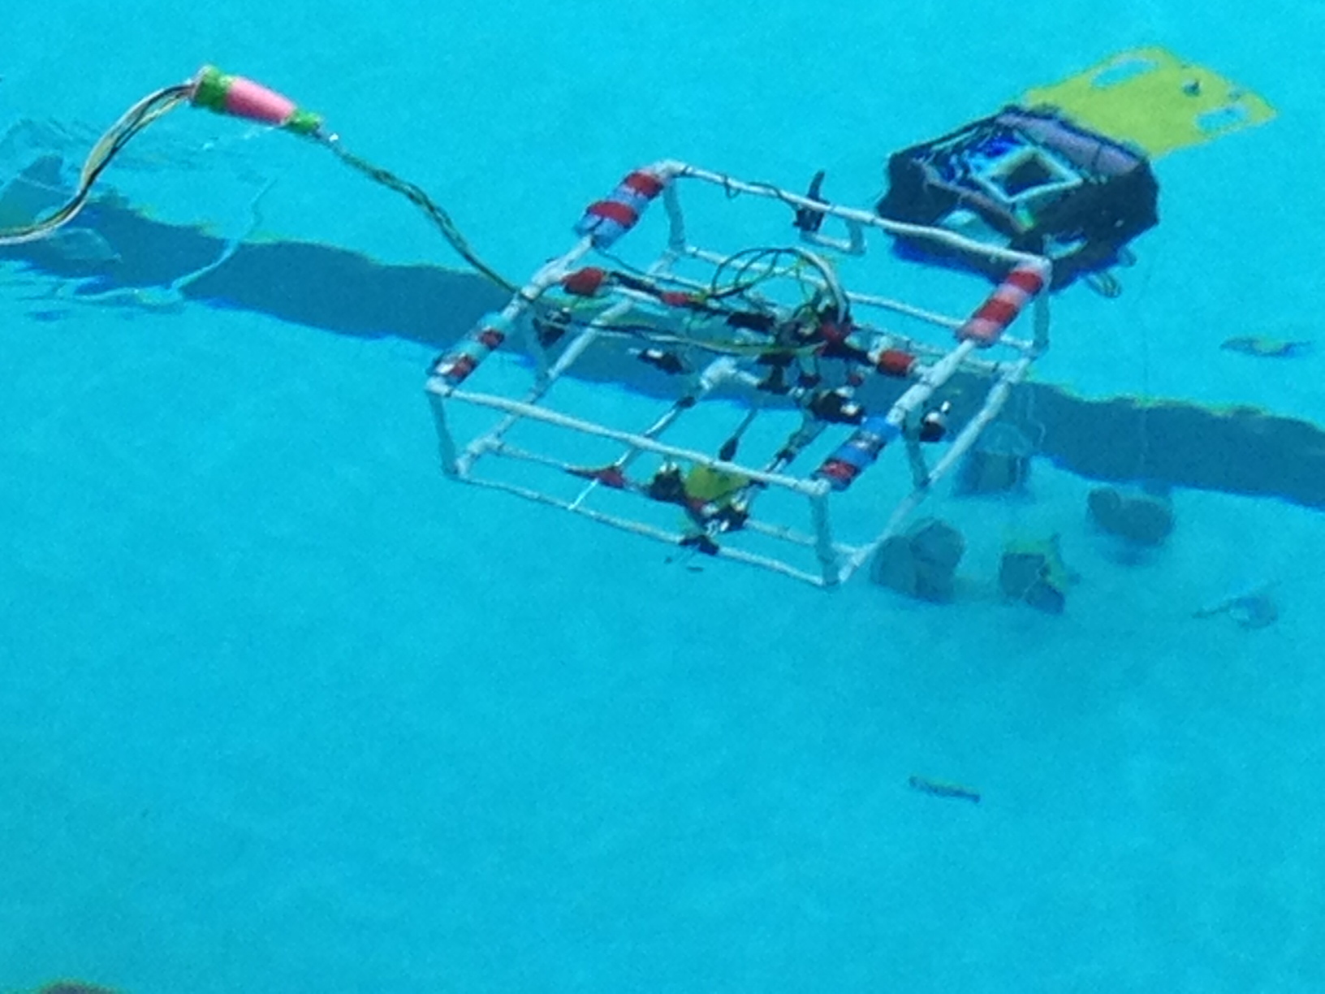

Slide 14
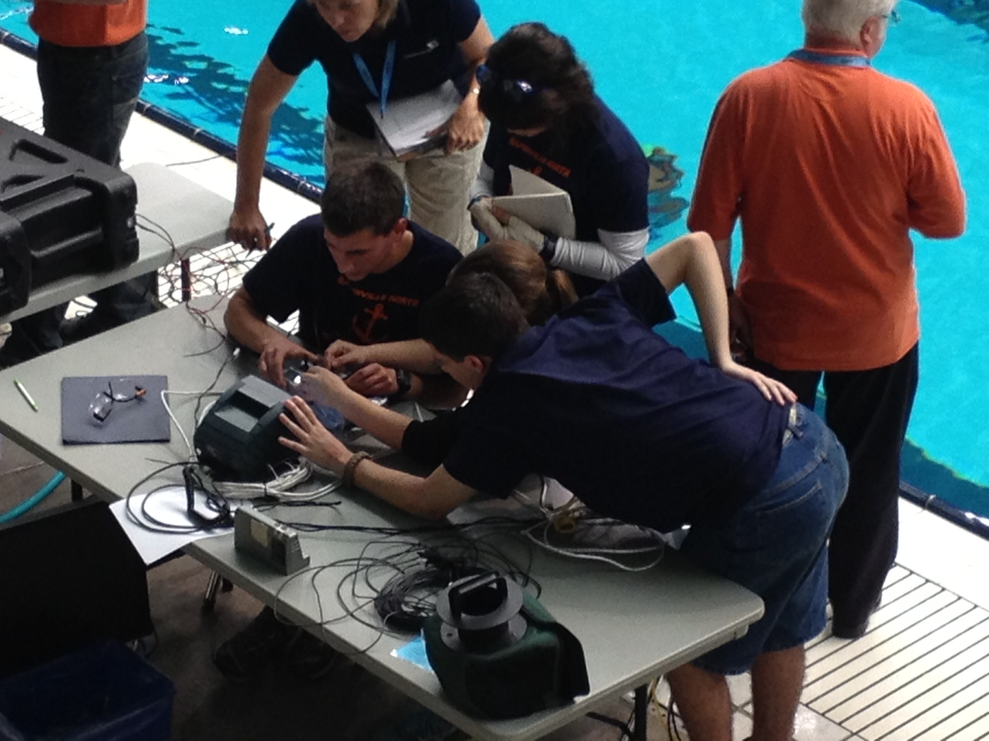

Slide 15
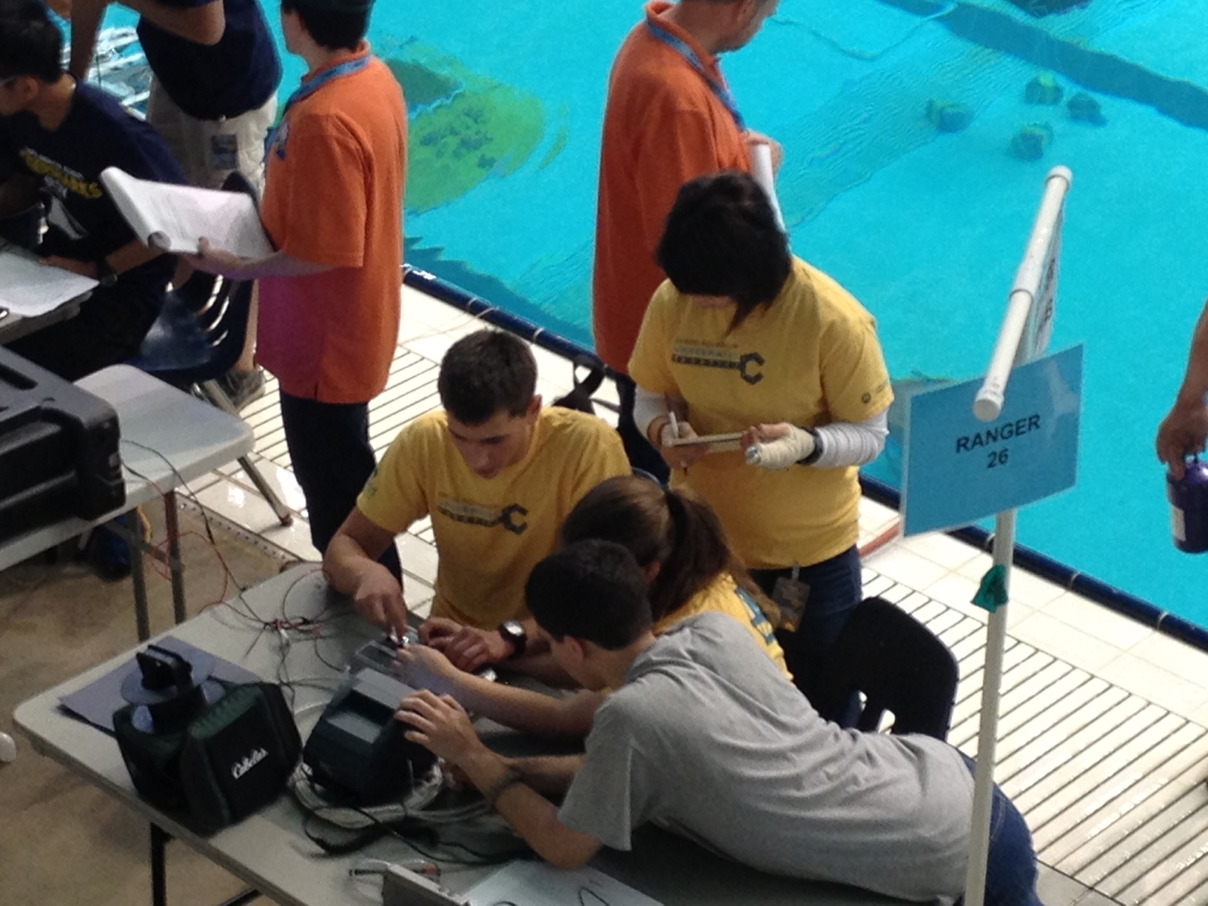

Slide 16
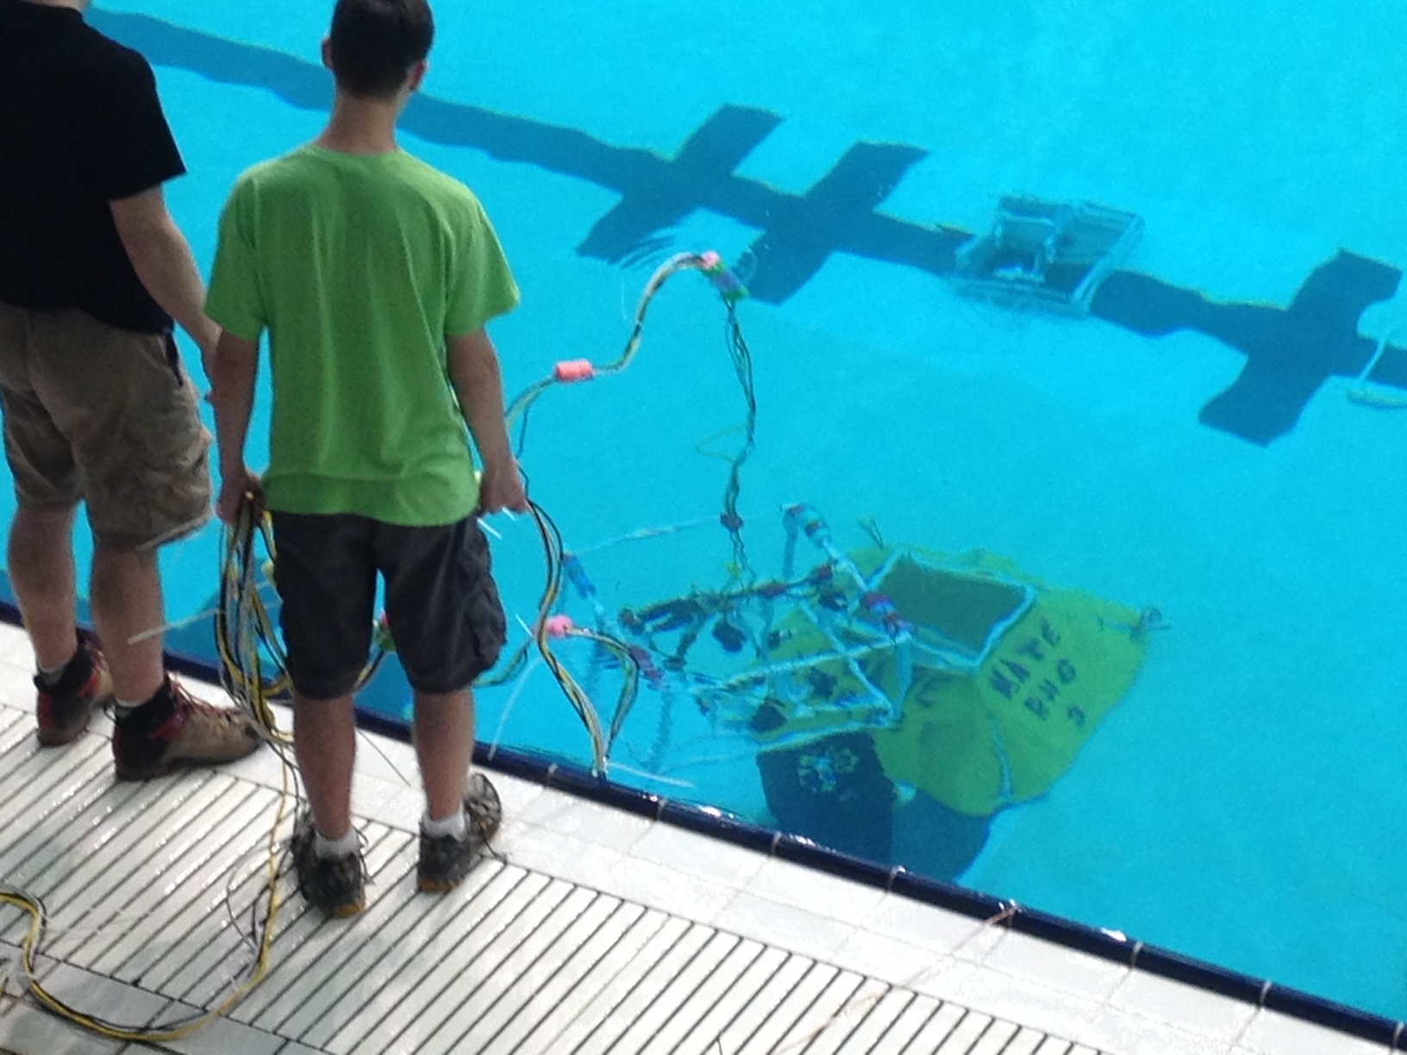

Slide 17
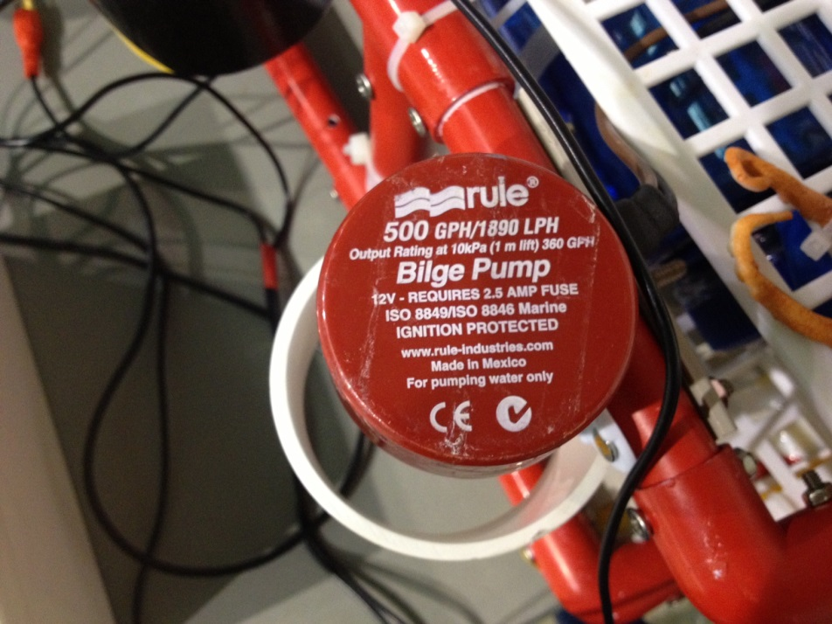
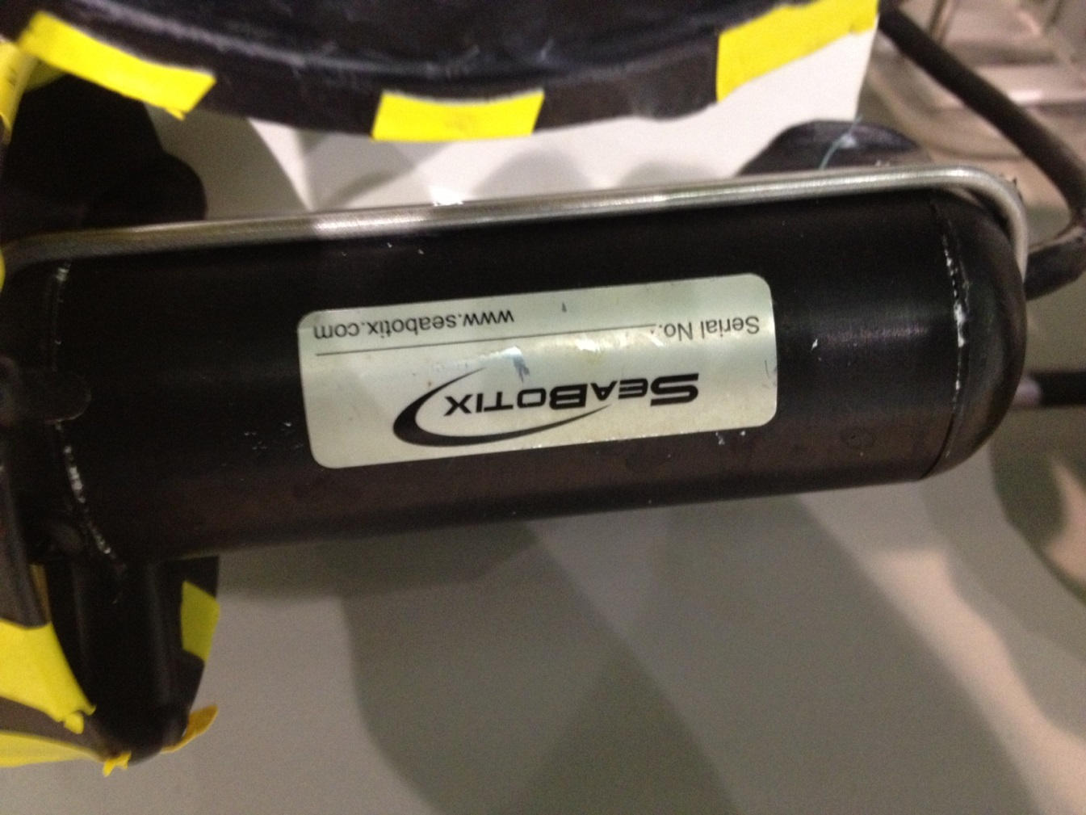

Slide 18
Concepts
Physics
Buoyancy, center of mass, torque
Chemistry
Water chemistry
Earth Science
Tectonics, currents, geology
Engineering
Electronics, wiring, waterproofing, aquadynamics, structural

Slide 19
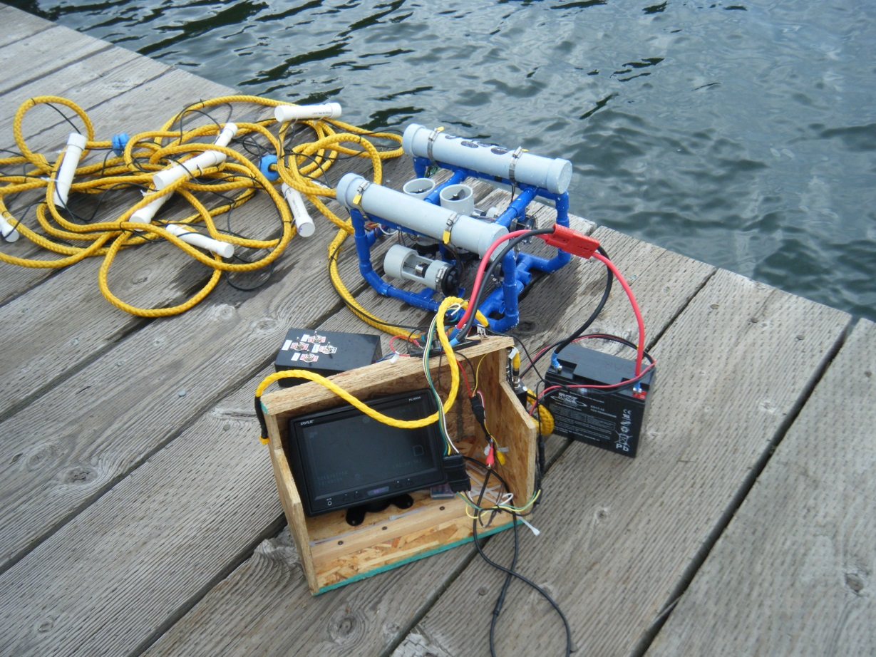
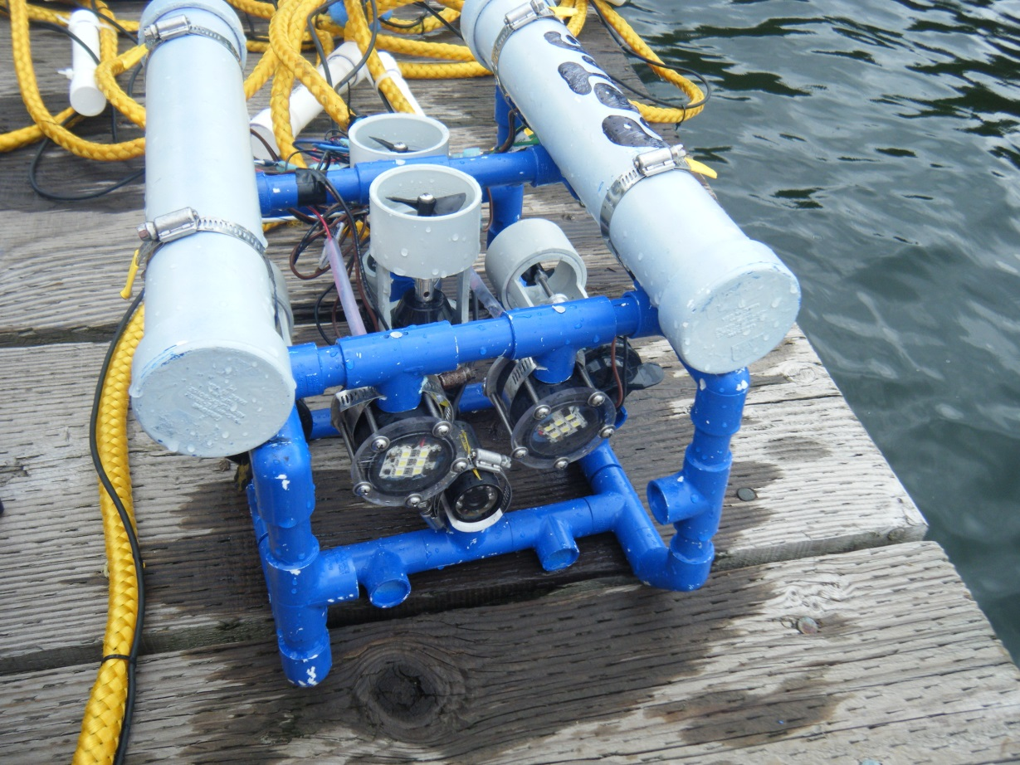
Application
Isle Royale N.P.- Windigo Ranger Station
Zebra Mussels!!

Slide 20
DIY ROV Resources
www.marinetech.org
http://www.luke.maurits.id.au/blog/post/building-a-diy-rov.html
http://www.instructables.com/id/Underwater-ROV/
www.diyrov.net
www.homebuiltrovs.com
www.openrovs.com
(Just search DIY ROVs)

