Slide 1
Double Pendulum Chaos Experiment
By: Casey Gravelle and Josh Lindoo

Slide 2
Chaos Theory
Small differences in initial conditions, lead to exponentially different outcomes
An example of a chaotic system is rolling a dice
Another example is a double pendulum
Chaotic Systems are deterministic, and do not contain random events, however, they are impossible to predict accurately over a long period of time

Slide 3
Pendulums
A pendulum is an object mounted so that it can swing freely.
A single pendulum’s motion is easy to predict because it follows very simple and consistent patterns.

Slide 4
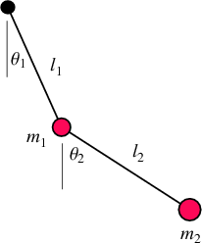
The Double Pendulum
A double pendulum is similar to a single pendulum, but it has a second pendulum attached to the bob.
Motion is chaotic and very difficult to predict

Slide 6
Last Year’s Research
Used an actual pendulum and magnetic encoders to measure its position in real time
Recorded Data using a cRio
Produced graphs of data to analyze trends

Slide 7
This Year
This year we focused on developing software that would enable rapid generation of data.
A second goal was to lead the way for other high school students to use their Quarknet cards for similar projects.
Many high schools already have the Quarknet board that we used and are using it as a cosmic ray detector

Slide 8
Pros and Cons of Simulation
Pros
Faster generation of data
Starting conditions are precise and many configurations can be tested rapidly
Data can be quickly and easily saved for later use
Cons
Due to the chaotic properties of the double pendulum, the results diverge from reality over time
It isn’t the actual double pendulum

Slide 9
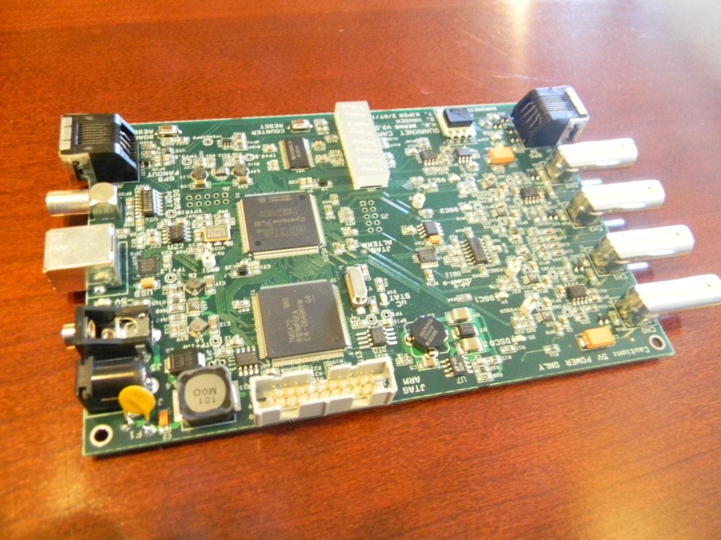
Hardware
Quarknet Card
FPGA
MicroProcessor

Slide 10
FPGA’s
The FPGA (Field Programmable Gate Array) is becoming more popular due to its rapid processing speeds, versatile applications, and flexible configurations.
Programmers with experience related to FPGAs are in high demand
Learning about FPGA programming is a valuable skill that students can learn by using the Quarknet board setup.

Slide 11
Software
LabVIEW
We used LabVIEW to write software that reads data from the Quarknet board and parses the data for visual exploration.
Quartus II
Quartus is the IDE (Integrated Development Environment) that we used to write and compile our VHDL code.
ModelSim
This tool was used to generate an accurate representation of the FPGA running our code.

Slide 12
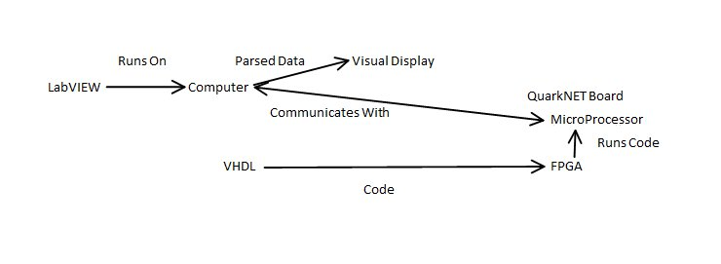
Communication Diagram

Slide 13
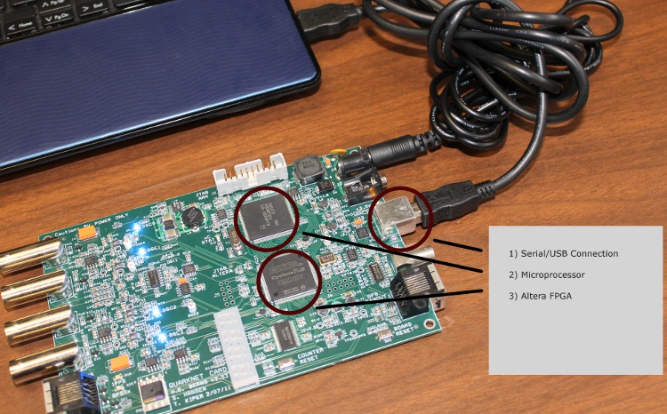

Slide 14
First Steps
Install Required Software
Basic Communications with the Quarknet card
Determine functionalities required for the project
Begin learning programming languages to write the software

Slide 15
Serial Communication
Our LabVIEW software communicates with the Quarknet board over USB (which then converts to serial).
In order to accomplish this, the program needs to open a connection, read/write the data, and then close the connection.
The first program we created was a basic terminal emulator.

Slide 16
Terminal Emulator

Slide 17
LabVIEW Code

Slide 18
String Parsing
The FPGA outputs data in a certain format. Our LabVIEW software needed to reformat the data in order to perform operations with it.
This process of analyzing a string and breaking it into smaller components is called “String Parsing”

Slide 19
String Parsing Format
01740FD2 AB CD 00 00 00 00 00 00 00000000 000000.000 00 0 +0000
Angle
Amplitude
Identifier
Unnecessary Information

Slide 20
Final FPGA Code
Calculates Sine and Cosine with 12 bits of accuracy
Cycles around the Unit Circle calculating Sine and Cosine
Stores the calculations in a FIFO buffer
Outputs these calculations to be read by a terminal

Slide 21
Final LabVIEW Program
Reads the output of the FPGA
Parses the data
Converts the output data into decimal
Graphs the results.

Slide 22
LabVIEW Front Panel

Slide 23
LabVIEW Code

Slide 24
Next Year?
Simulate a double pendulum
Easily record and interpret data
Due to the programs written this year, students will be able to continue the double pendulum project where we left off.

Slide 25
Special Thanks to the Mentors!
Teachers
Julia Dawson
Physicists
Fritz Dejongh
Sten Hansen
Terry Kiper
And many others!

