Slide 1
The Search for
Hypervelocity Stars
By Ben Brady & Konrad Genser
With the help of
Brian Yanny, Chris Stoughton, and
Heidi Newberg
August 5, 2011
Fermilab

Slide 2
Our Goal this Summer: Find More Hypervelocity Stars
Process:
Find out what is a Hypervelocity Star (HVS)
Follow what has already been done
Try to recreate results
Make our own searches

Slide 3
What makes HVSs special
A HVS is a Star that is moving exceptionally fast.
Fast enough to potentially escape the galaxy

Slide 4
How do they get so fast
Binary-star interaction with a black hole
Allows for the star to obtain very high speeds
Dwarf galaxy pulled in and shot back out
Explains why all of the stars are in the same area
Binary black hole and star
Gives the star a lot of speed

Slide 5
Purpose of finding HVSs
The position and velocity of HVSs can tell us more about the interactions of binary systems and Black Holes
HVSs can also act as probes for the dark matter halo around the Milky Way
The acceleration of the HVSs can help us get a more accurate idea of the mass of the galaxy

Slide 6
Dr. Warren R. Brown
Works at Smithsonian Astrophysical Observatory
Brown found first HVS in 2005
Currently 16 known HVS with a lot more possible HVSs

Slide 7
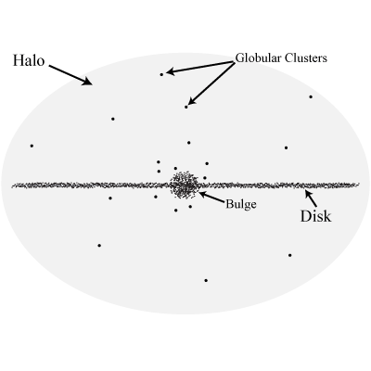
Where to start? In the Galactic Halo

Slide 8
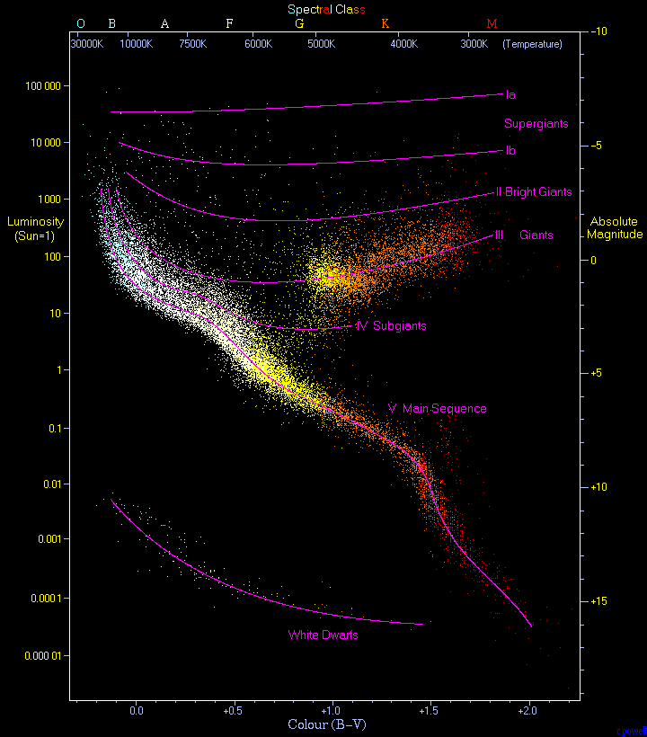
HR-Diagram

Slide 9
Young Blue stars

Slide 10
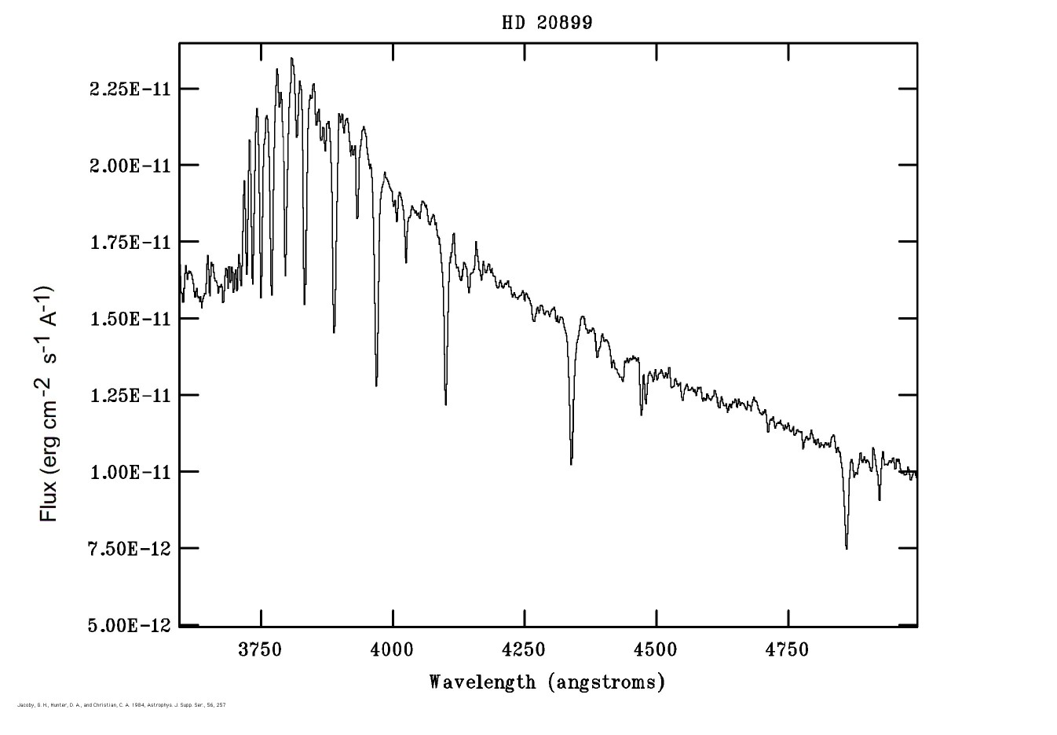
Spectra

Slide 11
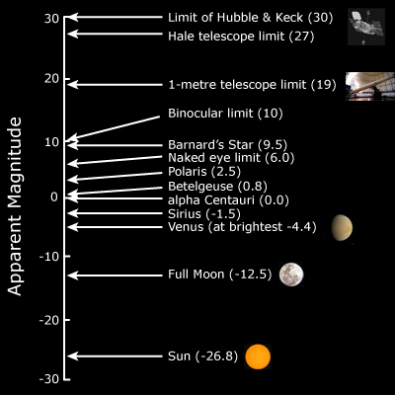
Magnitude
Apparent

Slide 12
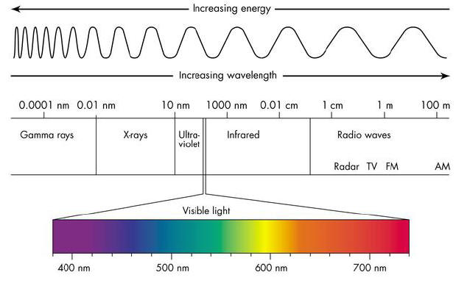
Color-Color diagrams
5 color filters
UGRIZ

Slide 13
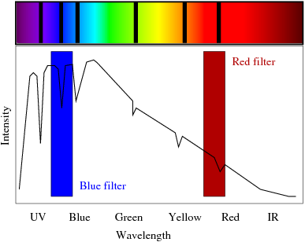
(u-g)₀ and (g-r)₀

Slide 14
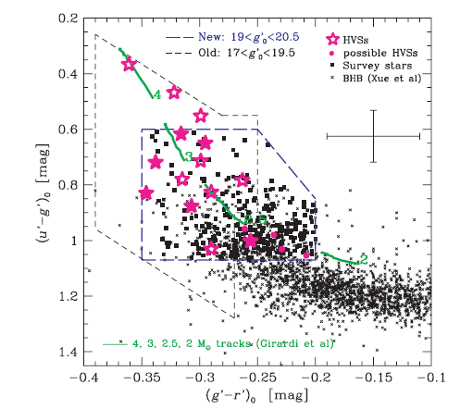
Color – color cut
1) .6 < u-g < 1.07
2) -.35< g-r < -.2
3) g > (18.6 + 10*(( g - r ) + 0.3) +(( u - g ) - (1.2*( g - r ) + 1.25))
4) (p.g-p.r) < (.2*(p.u-p.g)-.38)

Slide 15
Magnitude cut

Slide 16
Galactic Bulge Cut
(b >= ( -l/5 + 50) or b <= (l/5 – 50))

Slide 17
Sloan Digital Sky Survey
We used the SDSS database to search for HVSs
The goal of the SDSS
Make a map of the universe
2.5 m wide-angle optical telescope at Apache Point Observatory, New Mexico
Covers 14,555 square degrees on the sky
Observed about 500 million objects

Slide 18
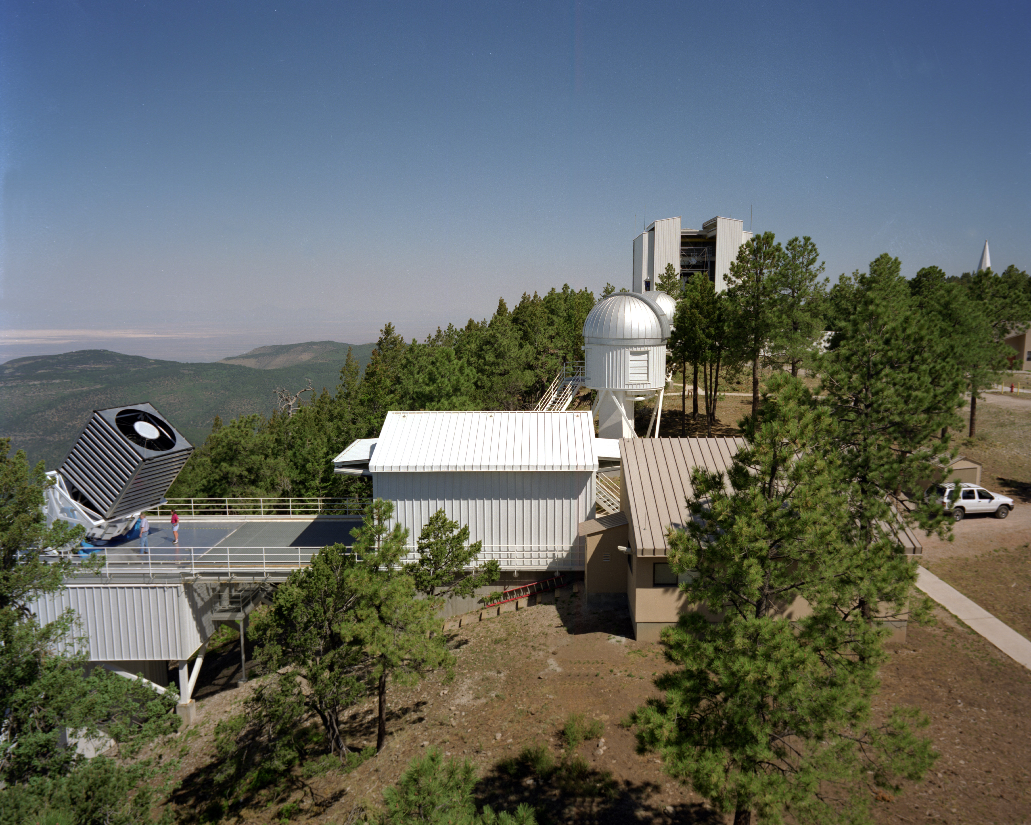

Slide 19
Retrieving the Data
Through CasJobs
Through Sky Server
Use a Microsoft SQL server
Relational database server

Slide 20
Final SQL query
Included all of the cuts made by Brown
select p.specobjid, p.ra, p.dec, p.l,p.b, p.u, p.g, p.r, p.i, p.z
from star p
Where
(p.g between 19.0 and 20.5)
and (p.u-p.g BETWEEN .6 AND 1.07)
and (p.g-p.r BETWEEN -.35 AND -.20)
and (p.r-p.i BETWEEN -.5 AND 0)
and p.clean=1
and) p.g > (18.6 + 10*(( p.g - p.r ) + 0.3) +(( p.u - p.g ) - (1.2*( p.g - p.r ) + 1.25))
and (p.g-p.r) < (.2*(p.u-p.g)-.38)
and (p.b >= ( -p.l/5 + 50) or p.b <= (p.l/5 – 50))
order by p.l

Slide 21
Our Results vs. Brown’s
585 objects compared to the 528 found by Brown
More results were expected since we used a later data release of SDSS
HVSs that we found
HVS1, HVS6, HVS10, HVS12, HVS13, HVS14, HVS15 HVS16

Slide 24
Experiments with the query
Widening of the color and magnitude range
Only asked for stars with spectra in the database
We used the table sppParams in order to get information about the surface gravities, metallicities, radial velocities, and signal to noise ratios of the stars

Slide 25
The new query returned 960 results due to the broader range in color
select p.specobjid, p.ra, p.dec, p.l,p.b, p.u, p.g, p.r, p.i, p.z, s.loggngs1, s.fehngs1, s.elodiervfinal, s.elodiervfinalerr, s.snr, s.zwarning
from star p, sppparams s
where
p.specobjid=s.specobjid
and (p.g between 14.0 and 25.0)
and (p.u-p.g BETWEEN 0 AND .5)
and (p.g-p.r BETWEEN -.6 AND 0)
and (p.r-p.i BETWEEN -.5 AND 0)
and p.clean=1
and p.g > (18.6 + 10*(( p.g - p.r ) + 0.3) +(( p.u - p.g ) - (1.2*( p.g - p.r ) + 1.25)))
and (p.g-p.r) < (.2*(p.u-p.g)-.38)
and (p.b >= (-p.l/5 + 50) or p.b<= (p.l/5 - 50))
order by s.elodiervfinal

Slide 26
Results
The fastest stars found were mostly White Dwarfs with the occasional A0 star
We found a white dwarf with small proper motions which indicate that it could be far away.
WDs are usually < 1 kpc away.
The WD has a reference frame velocity of 645 km/s
How could it have gotten that fast?

Slide 27
Interesting WD l=117.54,b=54.02

Slide 28
Possible HVS
An A0 star was found with a 580 km/s
Small proper motion which indicates it’s far away
False alarm
Was already found by Warren Brown

Slide 29
Brown’s HVS4

Slide 30
2nd modified query
Focus on the proper motion and velocity
Picked out the A0 stars from the results
select p.specobjid, p.ra, p.dec, p.l,p.b, p.u, p.g, p.r, p.i, p.z, s.loggngs1, s.fehngs1, s.elodiervfinal, s.elodiervfinalerr,pm.pmra,pm.pmdec,pm.pmdecerr,pm.pmraerr,s.mjd,s.plate,s.fiberid,s.teffngs1
from star p, sppparams s, propermotions pm
where
p.specobjid=s.specobjid
and p.objid=pm.objid
and p.clean=1
and (p.b >= (-p.l/5 + 50) or p.b<= (p.l/5 - 50))
and s.elodiervfinal between 400 and 500
and abs(pm.pmra) < pm.pmraerr and abs(pm.pmdec) < pm.pmdecerr
and s.elodiervfinalerr between 0 and 100
order by s.elodiervfinal

Slide 31
Results
32 results
12 of which were A0 stars with quality spectra
After initial analyzing of the data, only 2 of the twelve stars had enough velocity to possibly escape the gravity of the Milky Way Galaxy

Slide 32
Possible HVS
The first possible HVS has a reference frame velocity of 388 km/s at an approximate distance of 57 kpc from the galactic center.
The second possible HVS is on the border of being bound and unbound with a velocity of 317 km/s at an approximate distance of 61 kpc from the galactic center

Slide 33
Faster HVS l=189.57,b=24.91

Slide 34
Slower HVS l=236.12,b=41.18

Slide 35
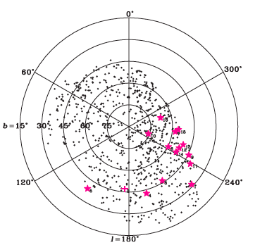
✪

Slide 36
Possible errors and problems in our expermient
One problem with this experiment was the lack of available spectra in the SDSS database
Another possible source for error is the approximation of the absolute magnitude of the stars when calculating the stars’ distance.
Some of the spectra observed were too noisy to be used

Slide 37
Conclusion
Possible HVS:
SDSS 3564692644586168320
SDSS 3551160954832134144
Interesting white dwarf
SDSS 412246250633586688

Slide 38
Further Research
Obtain better spectra to make better calculations
Time needed at a telescope
Observation proposal

Slide 39
Bibliography/WC/Credits
Thanks to Chris Stoughton, Brian Yanny, Warren Brown and Heidi Newberg for their help on the project.

